Slide 1
Kaggle Two-Sigma Apartment Interest Project
Project Team: Emil Parikh, and Glen Ferguson, Jason Chen

Slide 2
Description Variable
The description variable was unstructured html
"Spacious 1 Bedroom 1 Bathroom in Williamsburg!Apartment Features:- Renovated Eat in Kitchen With Dishwasher- Renovated Bathroom- Beautiful Hardwood Floors- Lots of Sunlight- Great Closet Space- Freshly Painted- Heat and Hot Water Included- Live in Super Nearby L, J, M & G Trains !<br /><br />Contact Information:Kenneth BeakExclusive AgentC: 064-692-8838 Email: kagglemanager@renthop.com, Text or Email to schedule a private viewing!<br /><br /><br /><br /><br /><br /><br /><br /><br /><br /><br /><br /><br /><br /><br /><br /><p><a website_redacted”
NLP from the tidytext package
The Ngrams (short phrases) from the library
Used SVM to classify, but this had no predictive power
Sentiment analysis
A column of the word counts for each sentiment, positive, negative, anticipation, fear, anger, joy, disgust, sadness, surprise, and trust
Positive was by far the most important!
aberration abhor abhorrent abject abnormal disgust

Slide 3
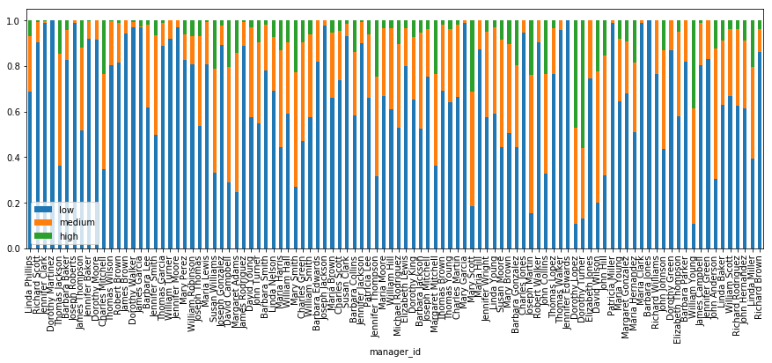
Manager ID
Based on a Kaggle Kernel, the Kernal has now been signficantly changed
Results in severe overfitting based on difference between validation score and Kaggle score.
Since the output was used to determine the fit there is leakage

Slide 4
Variable Importance

Slide 5
Correlation Plot Final Variables

Slide 6
Models
Tuning models provided limited benefit in all cases!
Logistic Regression
Ridge
Elastic Net
Standard implementations don’t predict high values even with CV
Not good at predicting medium
Random Forest (7 variables)
Ranger Implementation
Much faster than randomForest package
Very poor at predicting medium
H2O Gradient Boosting
Better at predicting high values, not as good at predicting lower values

Slide 7
Models – Logistic with Ridge

Slide 8
Models – Ranger

Slide 9
Models – GBM

Slide 10
Conclusions
Class imbalances and the Logloss metric rewarded models that fit low preferentially with some medium
Using up/down sampling of the data is is possible to increase accuracy
Increasing the accurate of high interest predictions
They tend to be worse at predicting medium interest
Feature engineering to improve classification of medium and high interest properties is important for model accuracy

